Slide 1




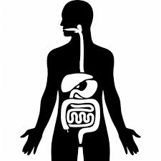
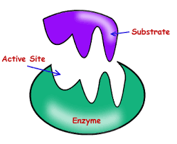

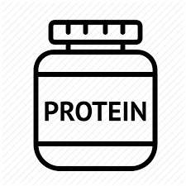

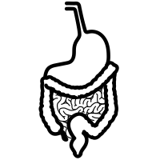
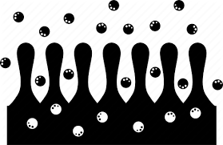
Organs
Denature
Lock & key Hypothesis
Topic 2: Organisation
Digestion
Digestive enzymes
Villi

Slide 2
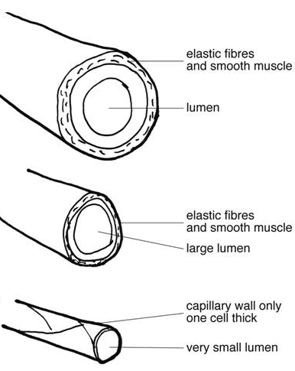
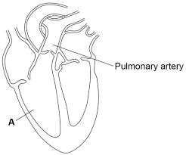
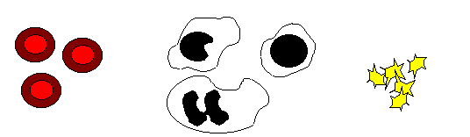
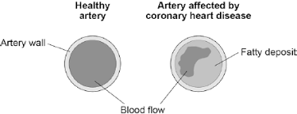
Heart structure
Blood vessels
artery
vein
Capillary
Topic 2: Organisation
Circulatory System
Components of blood
CHD
Red blood cell
White blood cell
platelets

Slide 3
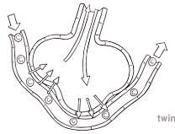
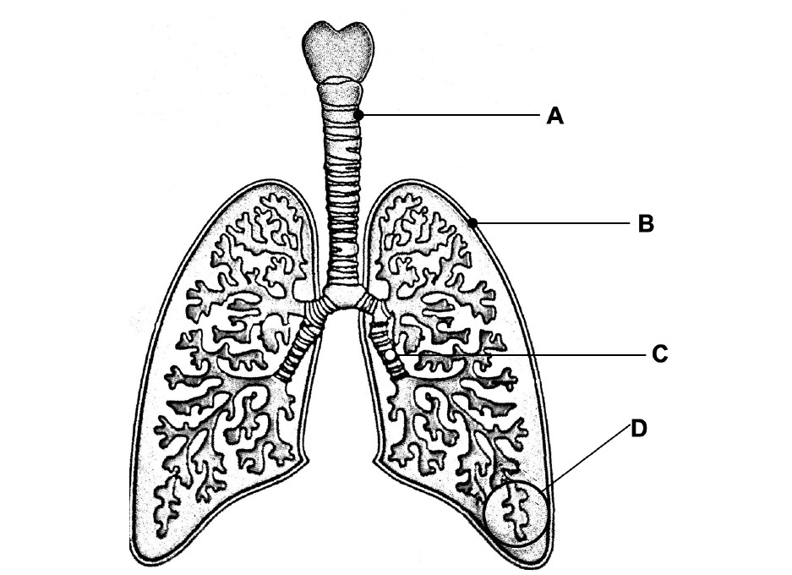
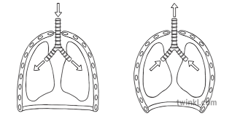
alveoli
structure
Topic 2: Organisation
Respiratory System
Ventilation

Slide 4
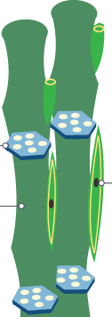
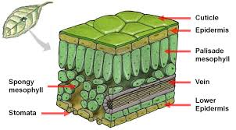
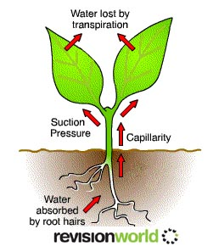
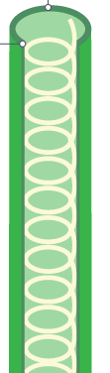
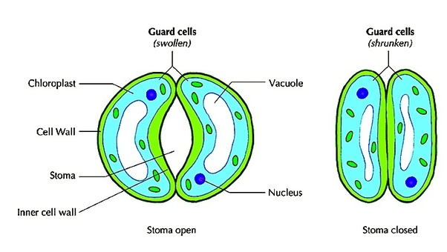
Phloem
Leaf structure
Topic 2: Organisation
Plant Organisation
Transpiration
Xylem
Guard cells & stomata

Slide 5


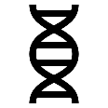



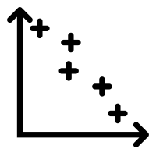

Communicable or non-communicable
Disease interaction
Topic 2: Organisation
Non-communicable Disease
Risk factors
Correlation & causation

