Slide 1


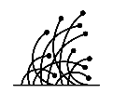



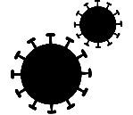
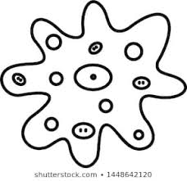
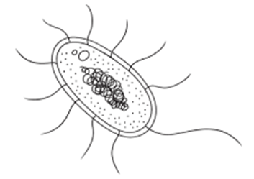
Fungi
Spread of disease
Topic 3 infection & response
Spread of disease & Pathogens
Virus
protists
Bacteria

Slide 2


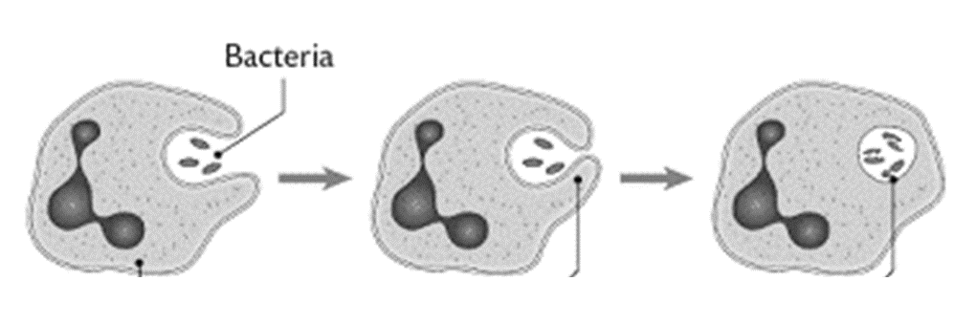
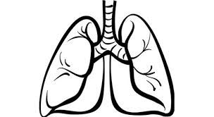
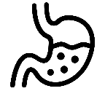
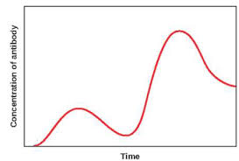

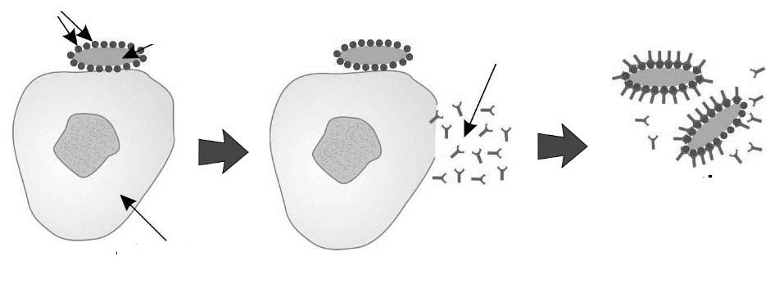
phagocytosis
Non-specific defence systems
Topic 3 infection & response
Human defence systems & vaccination
vaccination
Antibodies

Slide 3
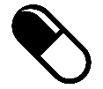
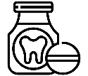


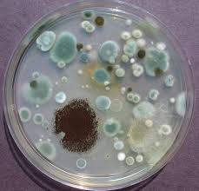
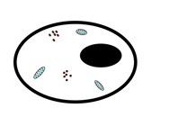


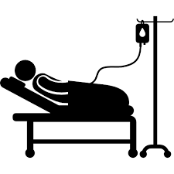
antibiotics
painkillers
Origins of drugs
Digitalis
Aspirin
Penicillin
Topic 3 infection & response
Antibiotics, painkillers & drug discovery
Drug discovery
Toxicity
Efficacy
Dosage
Placebo
Double blind
Pre-clinical trials
Clinical trials

Slide 4

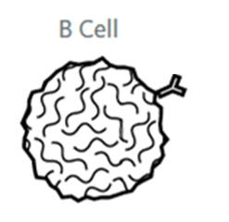
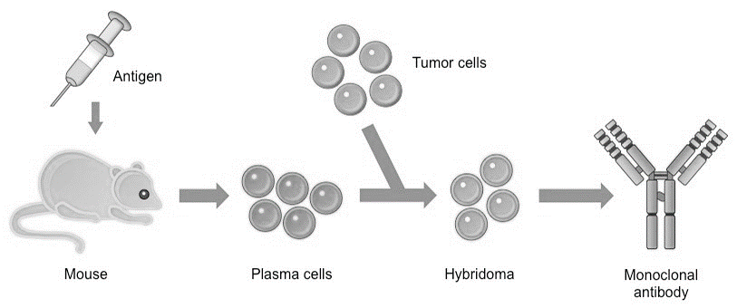
Monoclonal antibodies
Using monoclonal antibodies
Topic 3 infection & response
Monoclonal antibodies
Making monoclonal antibodies

Slide 5



Causes of disease
Signs of disease
NO₃⁻
Mg²⁺
Topic 3 infection & response
Plant diseases & responses
Plant defences

