Slide 1

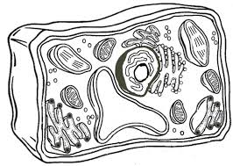

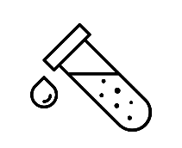

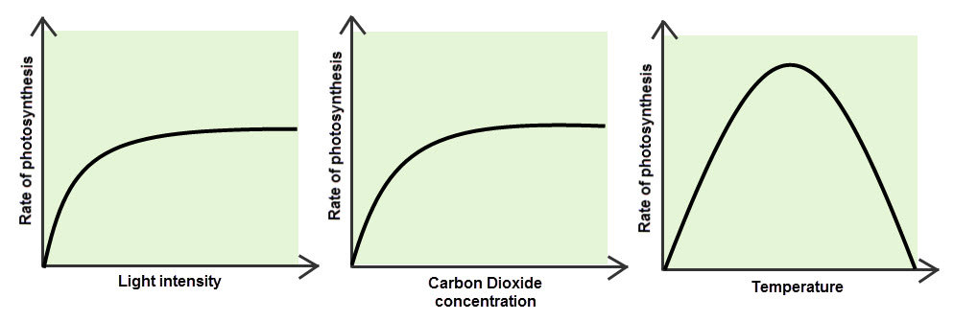
Equation
Word equation
Balanced symbol equation
Uses of glucose in plants
Topic 4 Bioenergetics
Photosynthesis
Greenhouses
Rate of photosynthesis – limiting factors

Slide 2

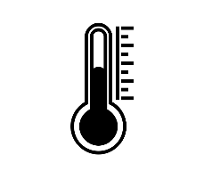
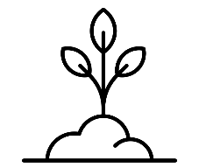


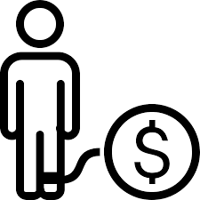
Aerobic respiration
Anaerobic respiration
Word equation
Balanced symbol equation
Uses for respiration
Topic 4 Bioenergetics
respiration
Exercise & Oxygen debt
metabolism

