Slide 1
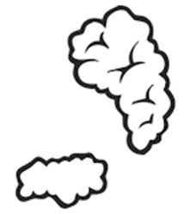
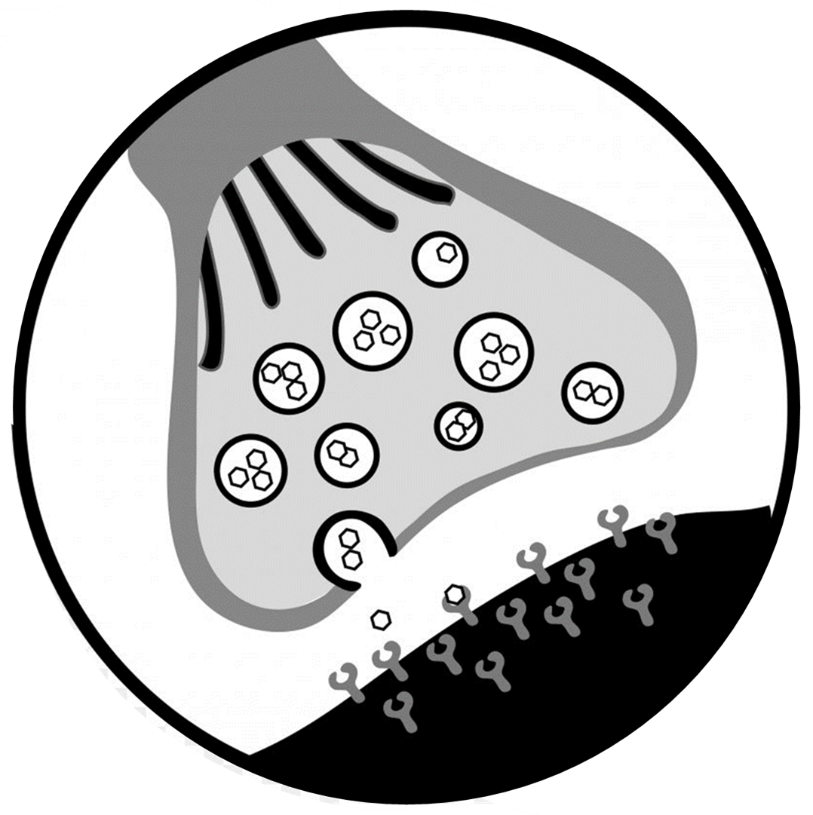
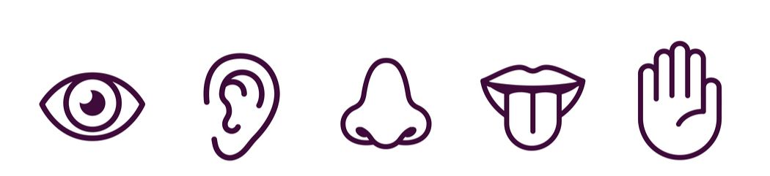

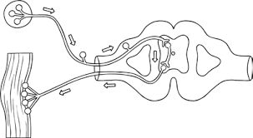
Receptors & effectors
synapses
Topic 5 Homeostasis & Response
Nervous Responses
Reflex arc

Slide 2
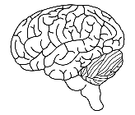

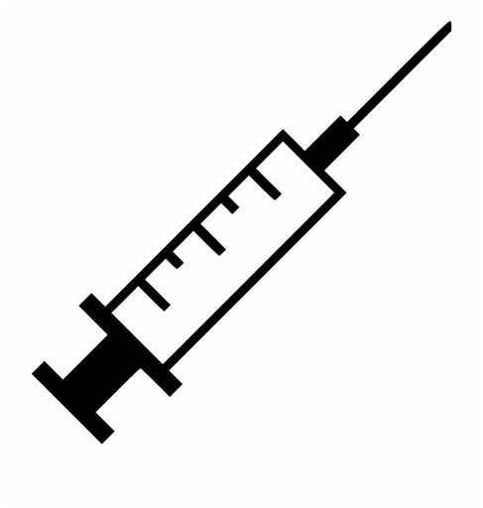

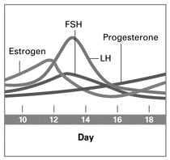
Hormonal regulation
Contraception & fertility treatment
Topic 5 Homeostasis & Response
Menstrual cycle, contraception & fertility
Menstrual cycle

Slide 3



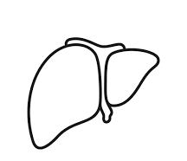

Type 1 diabetes
Blood glucose control
Topic 5 Homeostasis & Response
Blood glucose control & diabetes
Type 2 diabetes

