Slide 1

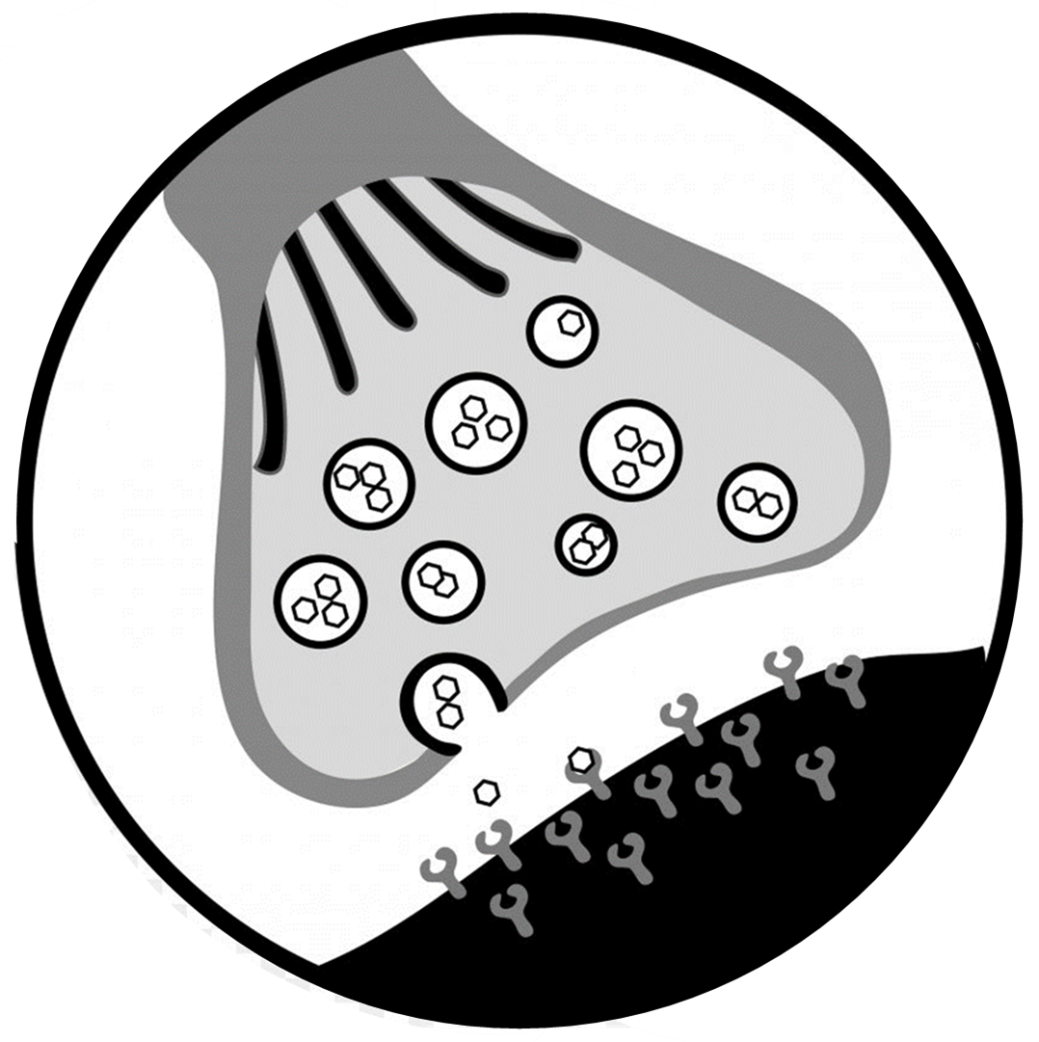
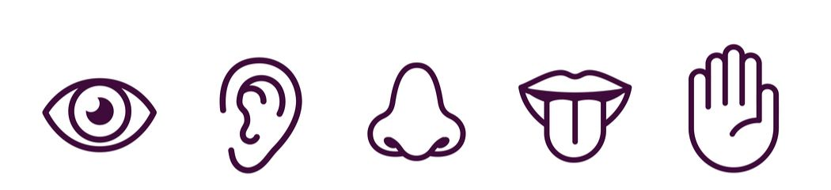

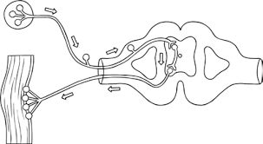
Receptors & effectors
synapses
Topic 5 Homeostasis & Response
Nervous Responses
Reflex arc

Slide 2
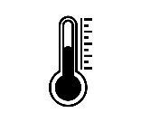
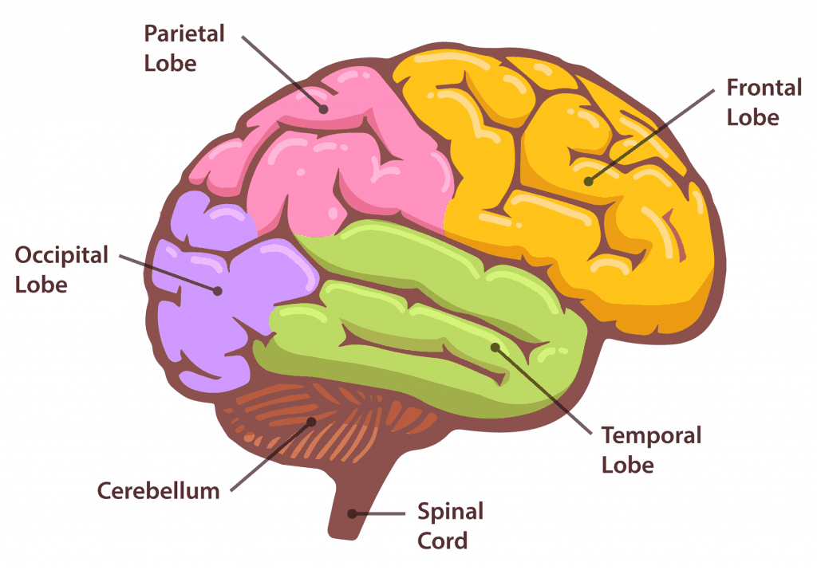
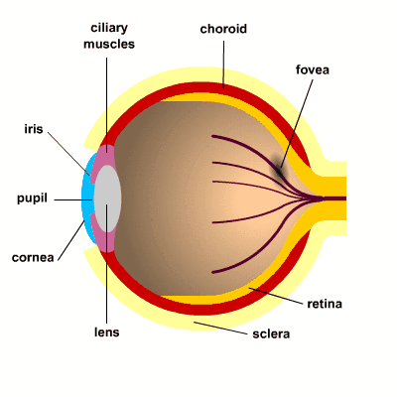
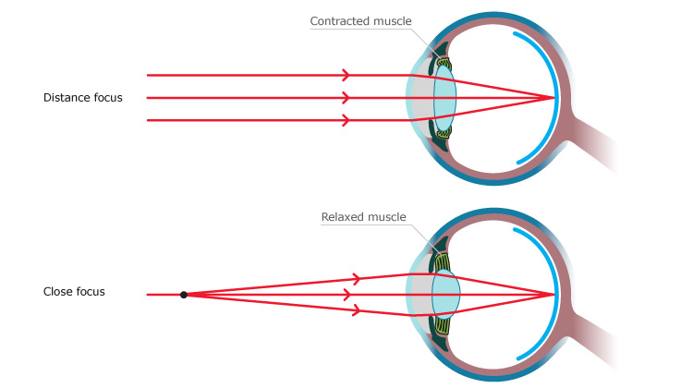
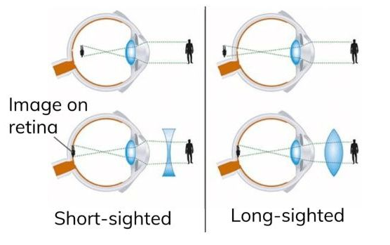
The brain
Body temperature
Topic 5 Homeostasis & Response
The Brain, Eye & Body temperature
Eye structure
accommodation
Defects of the eye

Slide 3
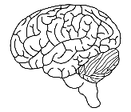

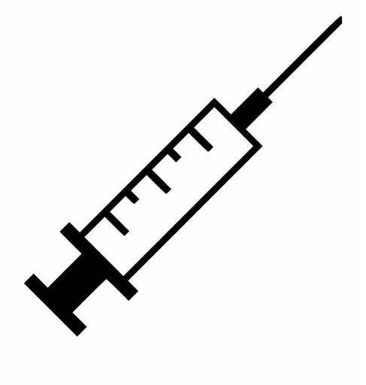

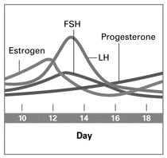
Hormonal regulation
Contraception & fertility treatment
Topic 5 Homeostasis & Response
Menstrual cycle, contraception & fertility
Menstrual cycle

Slide 4



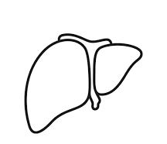

Type 1 diabetes
Blood glucose control
Topic 5 Homeostasis & Response
Blood glucose control & diabetes
Type 2 diabetes

Slide 5
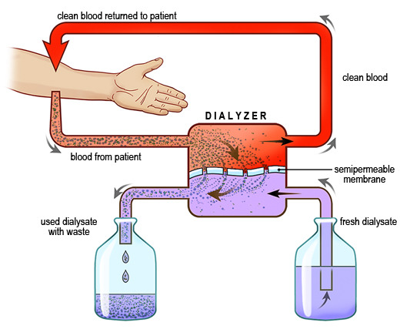
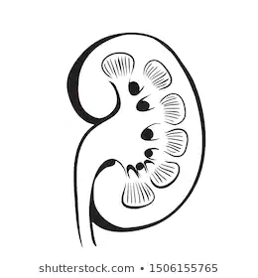
Hormonal regulation
dialysis
Topic 5 Homeostasis & Response
The Kidney

Slide 6
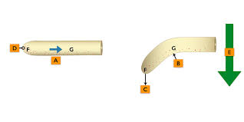
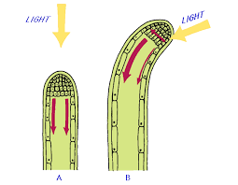
phototropism
geotropism
Topic 5 Homeostasis & Response
Plant hormones
Using plant hormones
auxins
gibberellin
ethene

