Slide 1
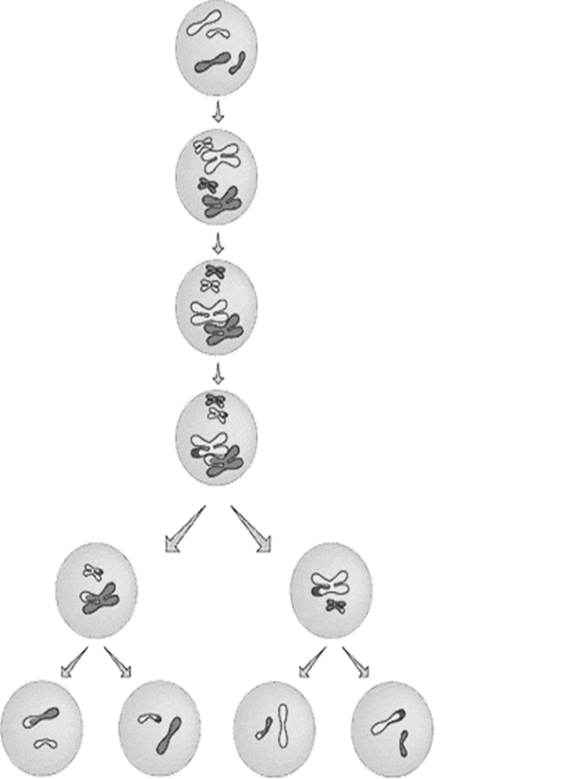
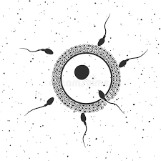
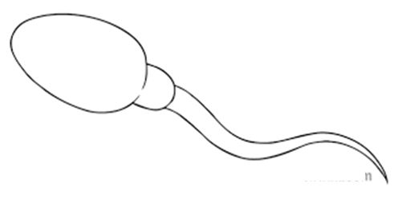
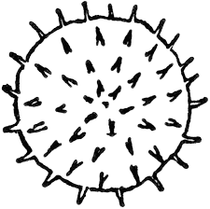
meiosis
definitions
Sexual reproduction
Asexual reproduction
Topic 6 Inheritance, Variation & Evolution
Sexual & Asexual reproduction
gametes

Slide 2
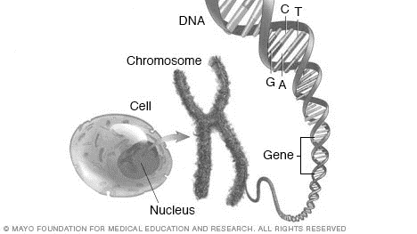
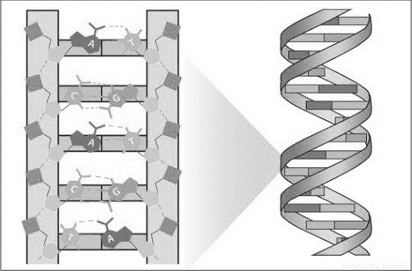

Dna
genome
Topic 6 Inheritance, Variation & Evolution
DNA, Genome & Mutations
Mutations

Slide 3
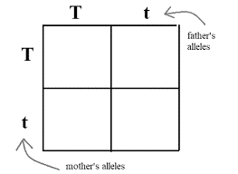
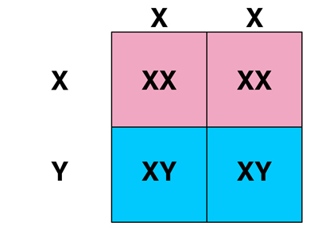


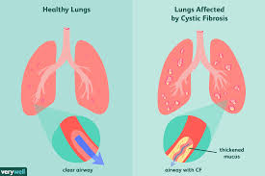
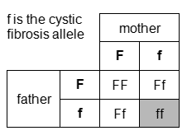
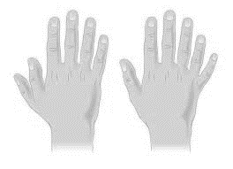
Punnett squares
Sex determination
Topic 6 Inheritance, Variation & Evolution
Genetic Inheritance
Inherited disorders
variation

Slide 4
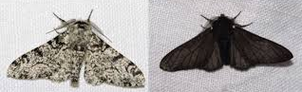
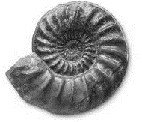
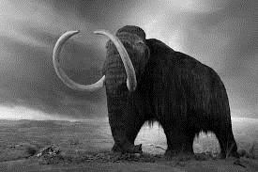
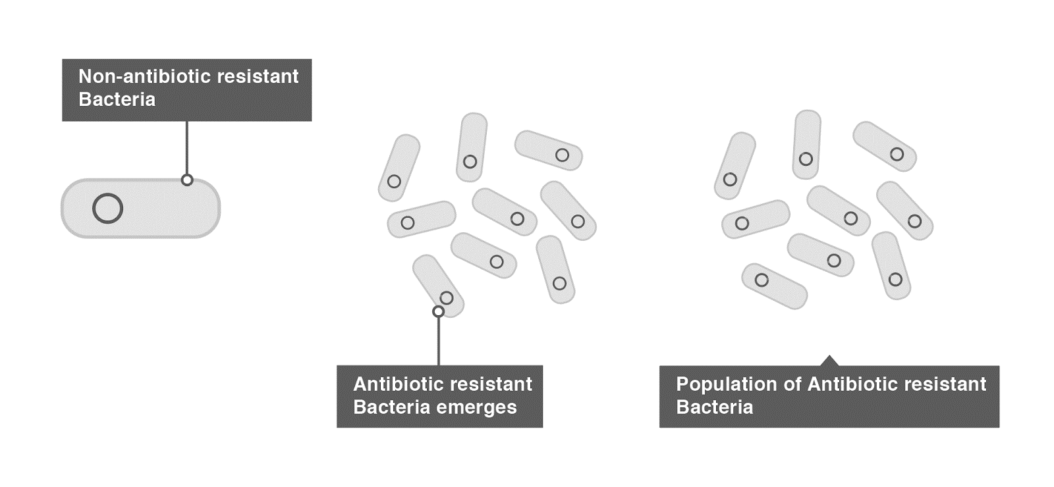
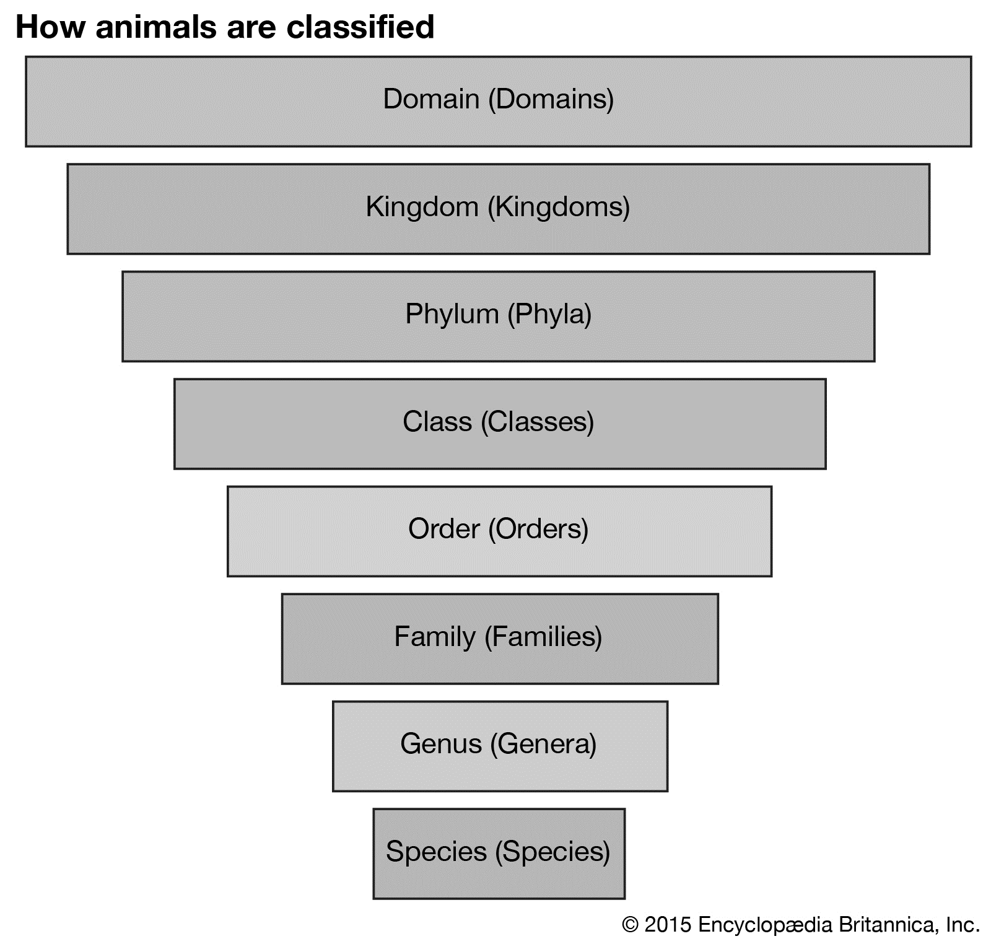
Natural selection
Evidence for evolution
Topic 6 Inheritance, Variation & Evolution
Evolution & Classification
extinction
classification
Antibiotic resistance

Slide 5
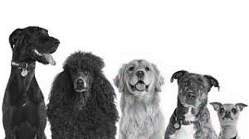
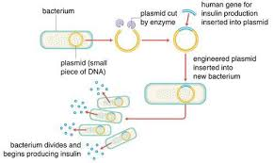
Selective breeding
Topic 6 Inheritance, Variation & Evolution
Selective breeding & genetic engineering
Genetic engineering

