Slide 1



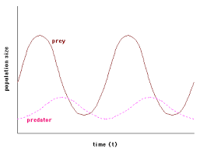
adaptations
Biotic & abiotic factors
Topic 7 Ecology
Adaptations, interdependence & competition
Predator prey cycle

Slide 2
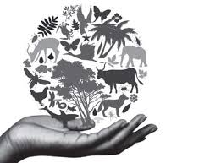
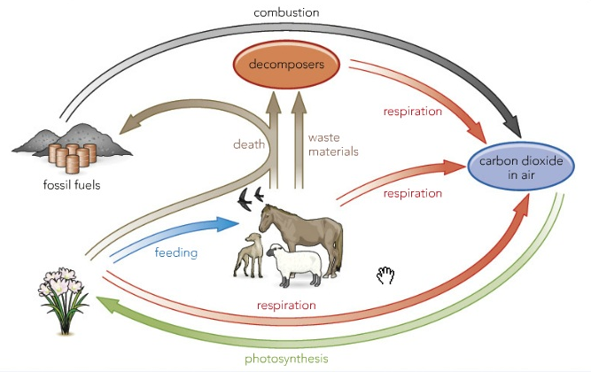
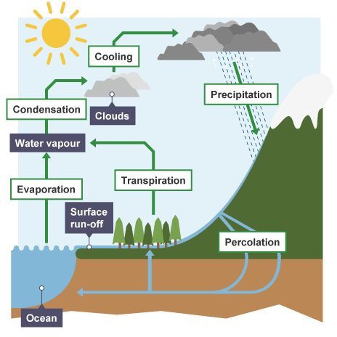
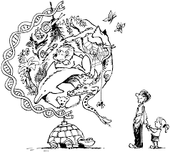
Carbon cycle
Water cycle
biodiversity
Topic 7 Ecology
Biodiversity & human Impact
Human impact on the environment
Land use
Deforestation
Waste management
Global warming

