Slide 1



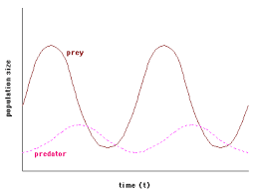
adaptations
Biotic & abiotic factors
Topic 7 Ecology
Adaptations, interdependence & competition
Predator prey cycle

Slide 2
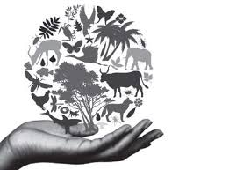
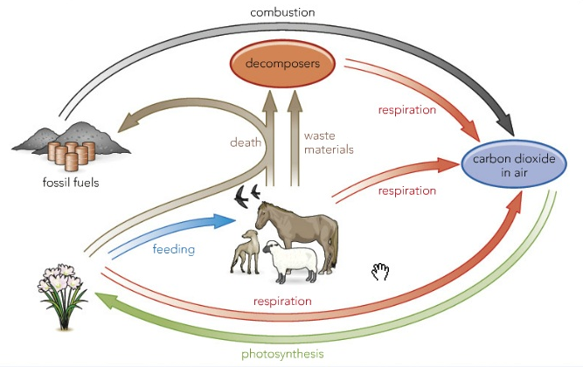
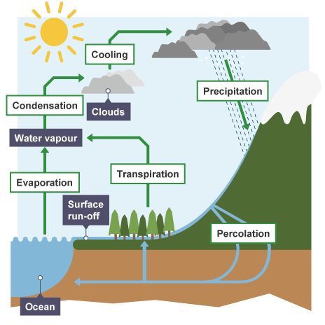
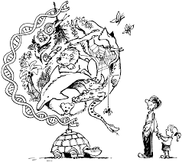

Carbon cycle
Water cycle
biodiversity
Topic 7 Ecology
Biodiversity & human Impact
Human impact on the environment
Decay & biogas
Land use
Deforestation
Waste management
Global warming

Slide 3
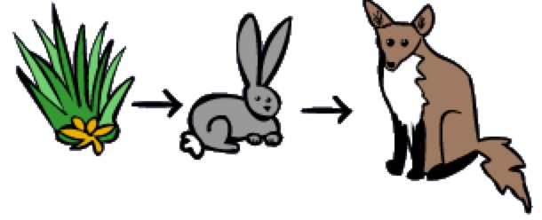
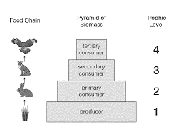
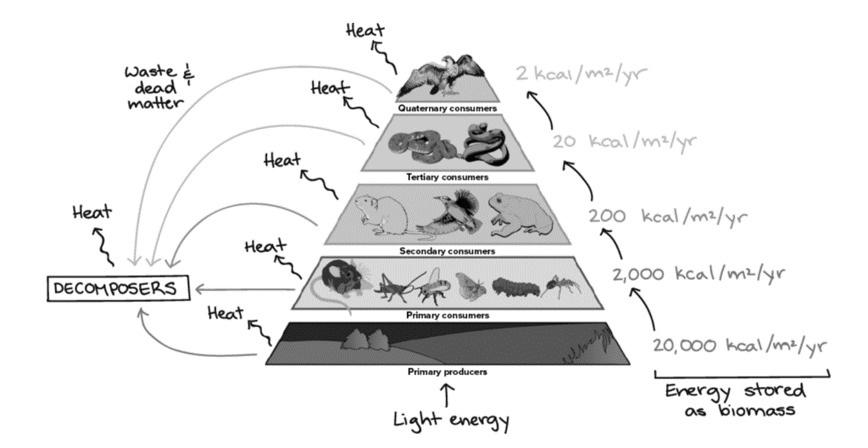
Food chains
Pyramid of biomass
Topic 7 Ecology
Trophic levels
Transfer of biomass

Slide 4



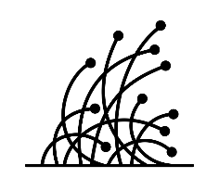

Food security
Farming techniques
Topic 7 Ecology
Food production
biotechnology

